Slide 1
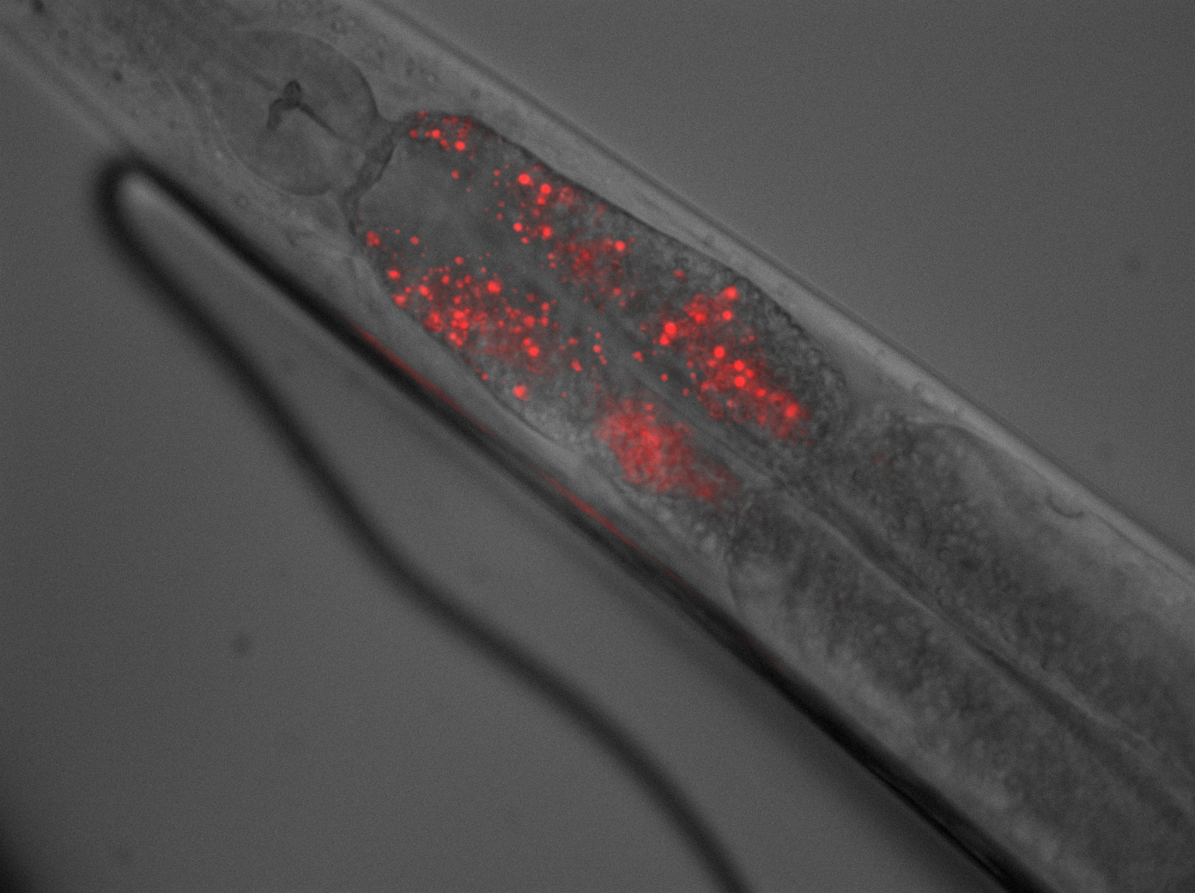
Brightfield Contrasting Techniques
Kurt Thorn
Nikon Imaging Center
University of California, San Francisco
USA

Slide 2
Generating contrast in light microscopy
Problem: Many biological specimens are thin and transparent and difficult to see.
Solution:
Fluorescent staining
Brightfield contrasting techniques: DIC, Phase, others
Brightfield
Phase Contrast
DIC

Slide 3
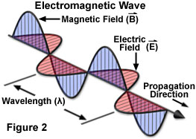
Polarization
Polarization: orientation of E-field.
Most light sources produce unpolarized light – no preferred polarization angle

Slide 4
Polarizers
Polarizers specifically transmit one polarization angle of light
Crossed polarizers transmit no light
X

Slide 5
Interference and polarization
In phase
linearly polarized
=
+
Phase lag
circularly polarized
=
+

Slide 6
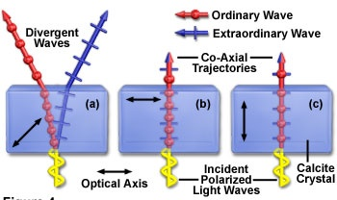
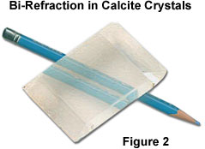
Birefringence
Birefringent materials have different indices of refraction for light polarized parallel or perpendicular to the optical axis.
Two beams with orthogonal polarization are produced if illumination is at an angle to optical axis

Slide 7
Differential Interference Contrast (DIC)
ΔOPL
The idea:
Use two beams and interference to measure the path length difference between adjacent points in the sample
n_{m}
n_{s}

Slide 8
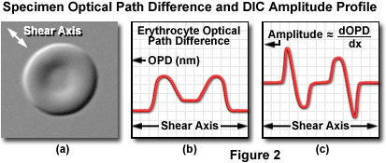
What DIC accomplishes
Converts relative differences in optical path length to
differences in amplitude

Slide 9
Features of a DIC image
Contrast is directional
Contrast highlights edges
One end brighter, other is dimmer
giving a pseudo – 3D image

Slide 10
Birefringence
Birefringent materials have different indices of refraction for light polarized parallel or perpendicular to the optical axis.
Two beams with orthogonal polarization are produced if illumination is at an angle to optical axis

Slide 11
Wollaston / Nomarski Prisms
Two pieces of cemented calcite / quartz
Produce orthogonally polarized beams propagating at different angles
Placed at a back focal plane, this produces the two beams that will probe the OPL difference of our sample
f
.

Slide 12
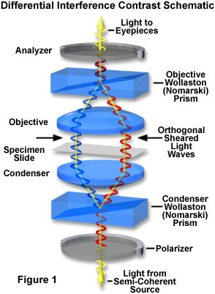
The differential interference contrast (DIC) microscope
Camera
Projection Eyepiece
Imaging
path
Tube lens
Polarizer (analyzer)
Wollaston
Objective
Sample
Condenser lens
Aperture iris
Wollaston
Field lens
Polarizer
Illumination
path
Field iris
Collector
Light source

Slide 13
How DIC generates contrast
X
Both beams see same OPL
Emerge in phase
Regenerate initial polarization
No light makes it through analyzer

Slide 14
How DIC generates contrast
Beams see different OPL
Right beam is phase retarded
Generate elliptical polarization
Light makes it through analyzer

Slide 15
How DIC generates contrast
X
Both beams see same OPL
Emerge in phase
Regenerate initial polarization
No light makes it through analyzer

Slide 16
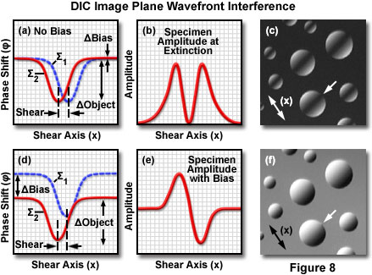
Role of Bias in DIC

Slide 17
Role of Bias in DIC

Slide 18
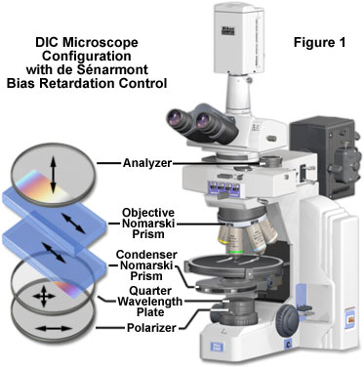

Slide 19
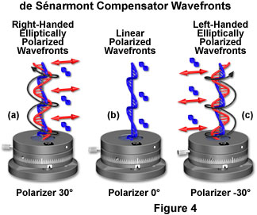
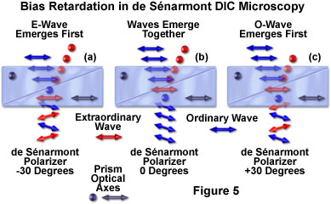
Bias adjusment in de Sénarmont DIC

Slide 20
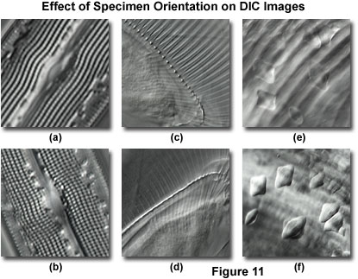
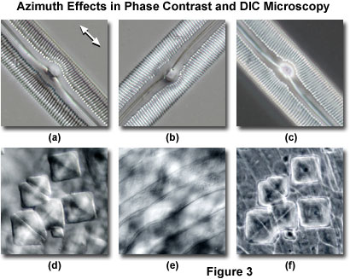
DIC is sensitive to specimen orientation

Slide 21
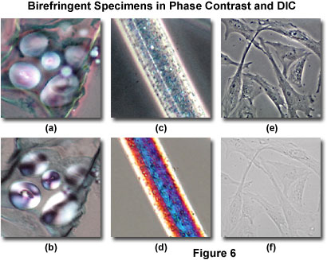
DIC doesn’t work on birefringent samples
Phase
DIC
Can’t plate cells on or or cover cells with plastic.

Slide 22
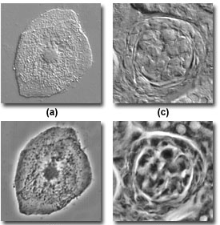
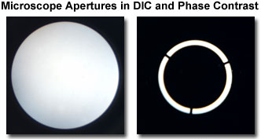
DIC is higher resolution than phase contrast
DIC
Phase

Slide 23
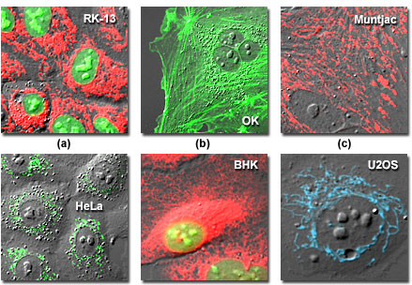
Combining Phase / DIC with fluorescence
To provide cellular or organismal reference.
Phase and DIC are more general (and less toxic) than fluorescence.
Phase and DIC do degrade fluorescence performance slightly

Slide 24
Bifrefringence in Biological Materials
Anisotropic materials will generally be birefringent
What’s anisotropic in the cell?
Polymers: DNA, actin, microtubules
Membranes

Slide 25
How to detect a birefringent material?
Start with crossed polarizers
X
Insert a birefringent material
X

Slide 26
Review: The Trans-illumination Microscope
Camera
Final image plane
Secondary pupil plane
Projection Eyepiece
Imaging
path
Intermediate image plane
Tube lens
Back focal plane (pupil)
Objective
Sample
Object plane
Condenser lens
The aperture iris
controls the range of
illumination angles
Aperture iris
(pupil plane)
Illumination
path
Field lens
Field iris
(image plane)
The field iris
controls the
illuminated
field of view
Collector
Light source
(pupil plane)

Slide 27
The Polarized Light Microscope
Camera
Final image plane
Secondary pupil plane
Projection Eyepiece
Imaging
path
Intermediate image plane
Tube lens
Analyzer polarizer
Objective
Sample
Object plane
Condenser lens
Aperture iris
Polarizer
Illumination
path
Field lens
Field iris
(image plane)
Collector
Light source
(pupil plane)

Slide 28
The Polarized Light Microscope
Imaging a normal sample
Intermediate image plane
Tube lens
Analyzer polarizer
Objective
Sample
Object plane
Condenser lens
Polarizer

Slide 29
The Polarized Light Microscope
Imaging a birefringent sample
Bifrefringent sample splits light into e- and o- rays, which see different refractive indices
The phase retardation of one ray with respect to the other gives rise to elliptically polarized light, which is transmitted by the polarizer
Tube lens
Analyzer polarizer
Objective
e
o
o
e
Sample
Object plane
Condenser lens
Polarizer

Slide 30
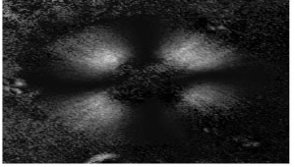
The Polarized Light Microscope
Imaging a birefringent sample
Tube lens
Analyzer polarizer
Objective
e
o
o
e
Sample
Object plane
Condenser lens
Birefringent sample is bright on dark background
Polarizer

Slide 31
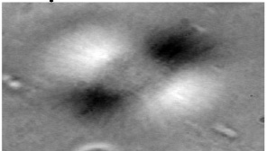
The Polarized Light Microscope
Add a compensator (wave plate) for better contrast
Tube lens
Analyzer polarizer
Objective
e
o
o
e
Sample
Object plane
Condenser lens
Compensator
Polarizer

Slide 32
Commercial implementation: LC-Polscope (Abrio)
Uses a circular polarizer analyzer and variable liquid crystal retarders to measure orientation independent polarization.

Slide 33
Polarized light microscopy
Good for
Seeing ordered structures in the cell:
Spindles
Other cytoskeletal structures
Membranes
Collagen
No staining required!

Slide 34
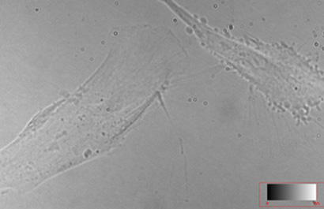
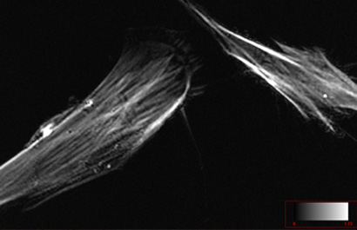
Examples – astrocyte (from CRI)
Brightfield
Polarization

Slide 35
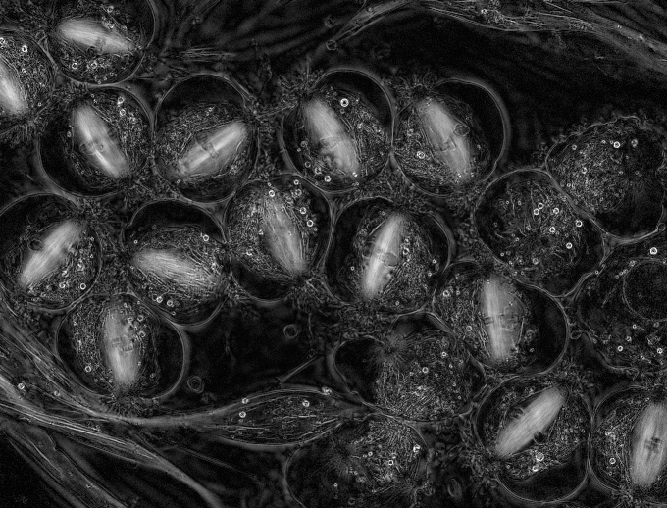
Crane Fly Spermatocytes
Rudolf Oldenbourg and James LaFountain

Slide 36
Further reading
www.microscopyu.com
micro.magnet.fsu.edu
Douglas B. Murphy, “Fundamentals of Light Microscopy and Electronic Imaging”
Hecht, “Optics”
Slides available: http://nic.ucsf.edu/dokuwiki/doku.php?id=presentations
Acknowledgements
Orion Weiner / Mats Gustafsson / Rudolf Oldenbourg

